Slide 1
Western PA Market Overviews
ICSC 2013 Ohio/West Virginia/Indiana/Western Pennsylvania
Idea Exchange
August 2013
Presented By: Jason Cannon
Vice President, CBRE

Slide 2
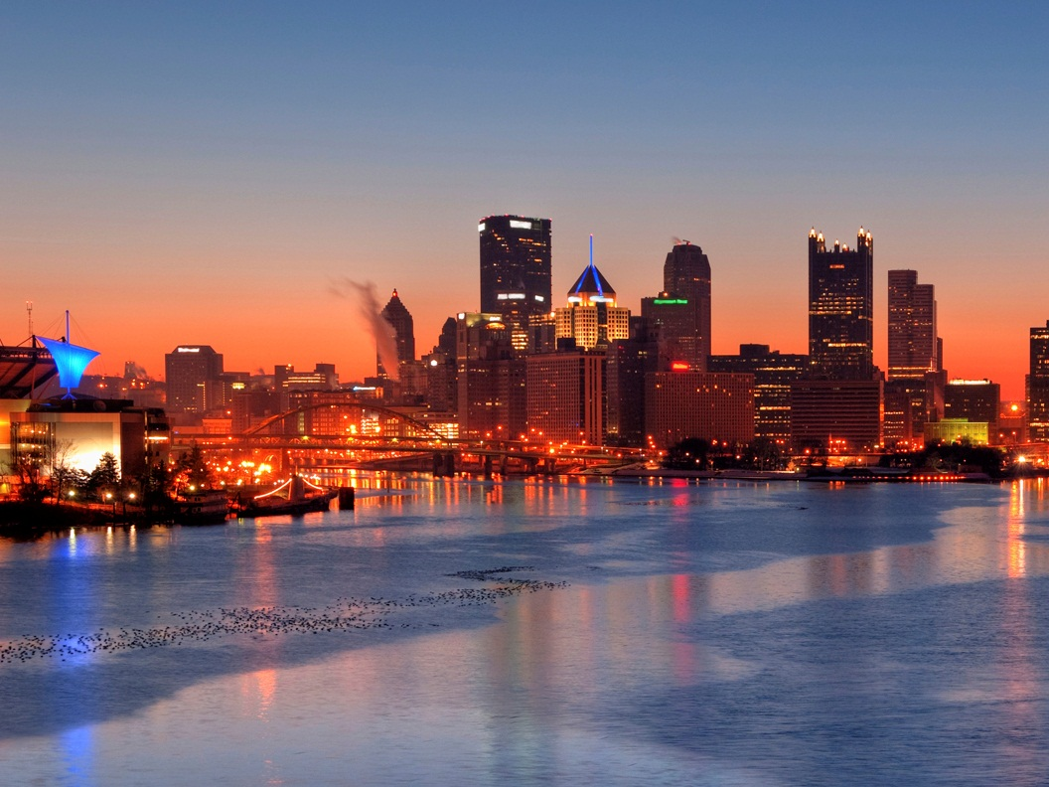
Most Livable U.S. City
The Economist
Top 10 American Comeback Cities
Forbes
U.S. Tech 20 Office Market City
CBRE Global Research & Consulting
A Top 10 Metro Area for Brain Gain
Wall Street Journal
A Top America’s City of the Future
fDi
No. 1 Best City to Relocate to in the U.S.
Sperling’s Best Places
Economically Strongest U.S. Metros
The Brookings Institute
Best of the World
National Geographic Traveler
Best Commercial Real Estate Market
Moody’s
A Top International Destination for 2013
Jetsetter.com
Top 10 Strongest Retail Market
ChainLinks Retail Advisors
Top 10 Happiest Cities to Work
CareerBliss.com
Best City for Recent Graduates
Huffington Post
Top 10 Best Cities for Job Growth
New Geography
Least Costly Place to Do Business
KPMG
Top 10 Great Cities for Starting a Business
Kiplinger

Slide 3
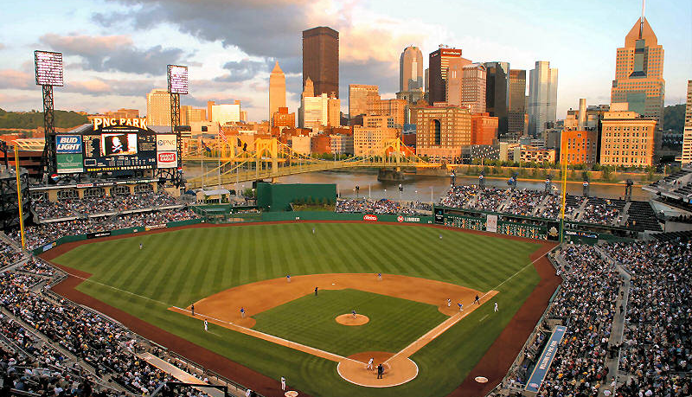
Market Fast Facts
Population(DMA) | 2,847,836
Growing Areas | Cranberry Township, Robinson Township, McCandless Township, Downtown Pittsburgh
Major Employers | UPMC Health System, US Government, Commonwealth of Pa, University of Pittsburgh, Energy Companies
Regional Draws | Pirates, Steelers, Penguins, Cultural District, Pittsburgh Zoo & Aquarium, Carnegie Museums, David L. Lawrence Convention Center, Rivers & Meadows Casinos, The Strip District, Market Square
Newsworthy Trends |
  Residential boom in CBD
  Growing population in region
  Expansive energy sector growth
  Constantly improving culinary scene
  Office occupancy is at 95%ish…
Jason Cannon
CBRE
Vice President
+1 412 394 9805
jason.cannon@cbre.com

Slide 4
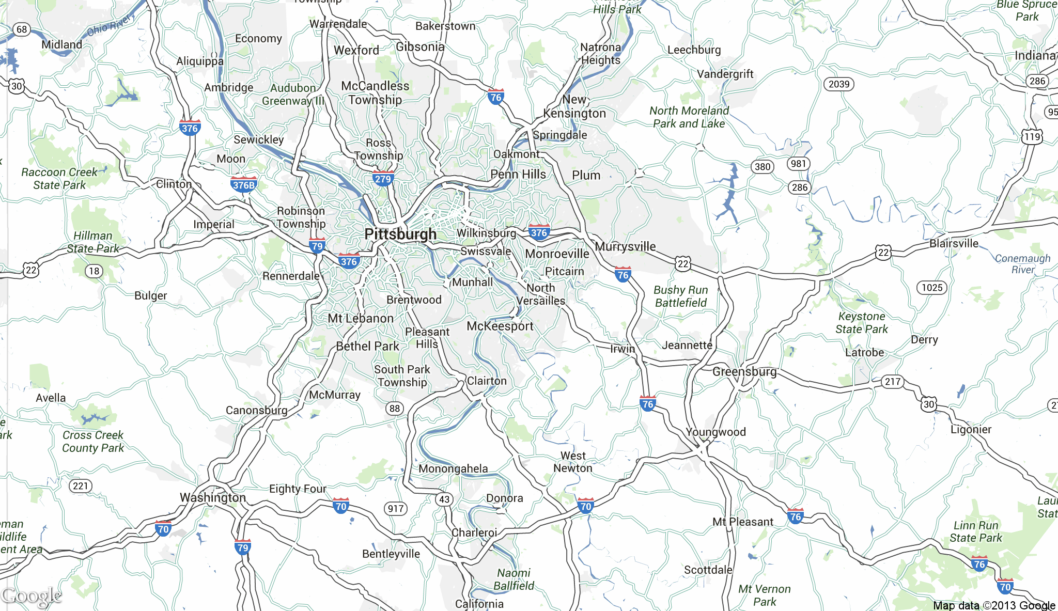
Overall Market Map

Slide 5
New Projects
350 Fifth Avenue
Blue Spruce Shoppes
McCandless Crossing
Newbury Market
Route 19 and Rochester Road (Name TBD)
Siena at St Clair
Southpointe Town Center
The Gardens
The Street at the Meadows
The Tower at PNC Plaza
North Shore – Phase II

Slide 6
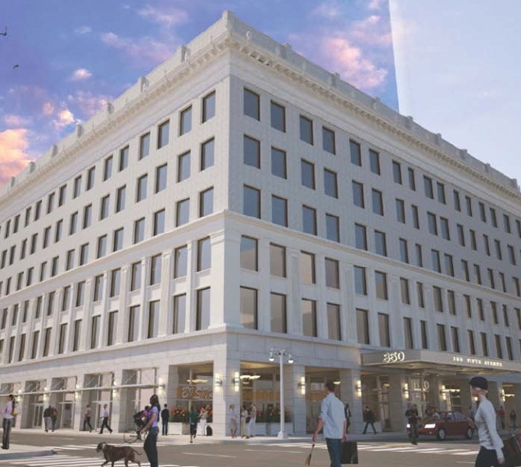
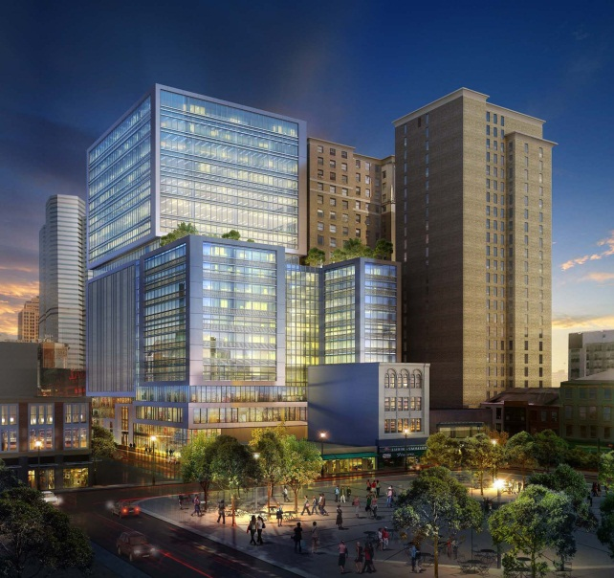
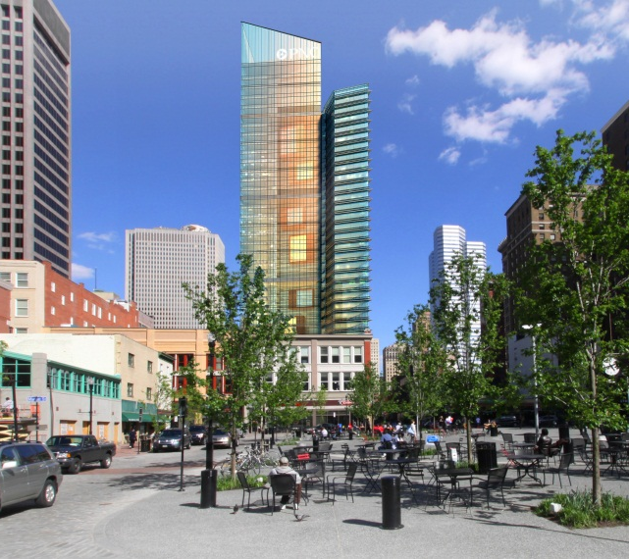
New Projects
350 Fifth Avenue Complete renovation of 441 Smithfield Street with new Fifth Avenue entrance and address Located directly across from Macy’s on the same block as the Tower at PNC Plaza 153,805 square feet of Class A Office space 22,600 square feet of retail and restaurant space | The Gardens New development near The Tower at PNC Plaza and Market Square 22,500 square feet of retail and restaurant space Up to 120,000 square feet of office space Tenants include 175 room Hilton Garden Inn and Burgatory 300 parking spaces | The Tower at PNC Plaza The world’s greenest skyscraper $400 million, 800,000 square feet Class A office tower 40 stories Will house 3,000 PNC employees

Slide 7
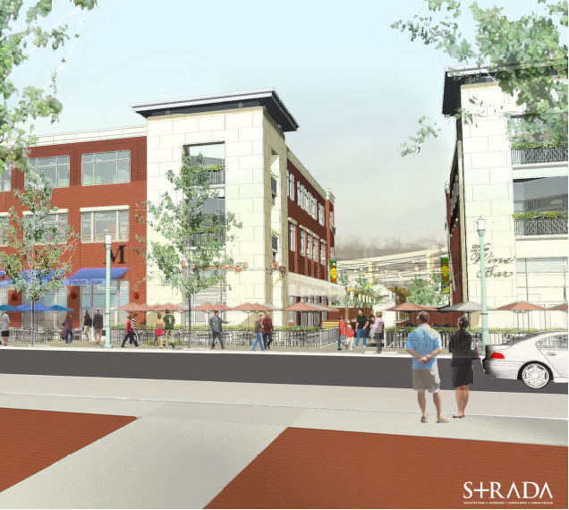
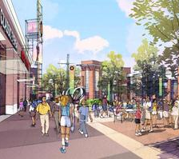
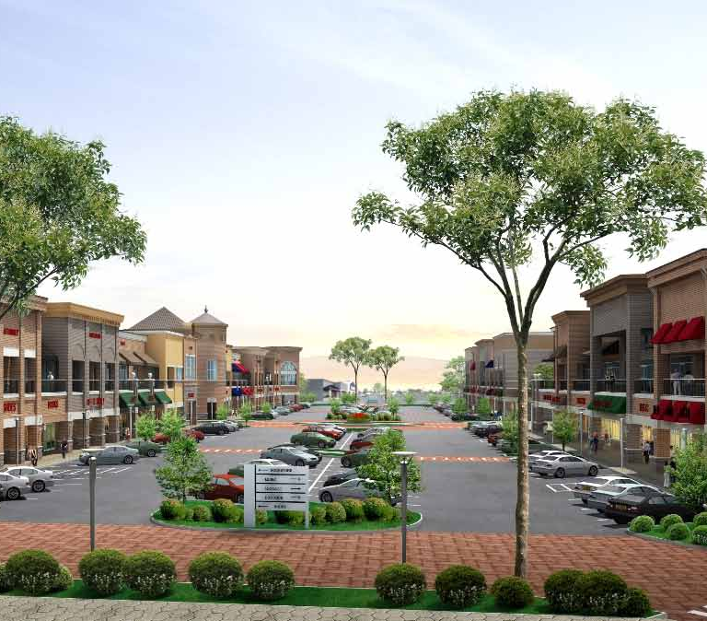
New Projects
North Shore – Phase II Current tenants include Bettis’ 36 Grille, Hyde Park Prime Steak House, Rivertowne, Tilted Kilt, Pittsburgh Grille and Sports Bar and Root Sports New tenants include Toby Keith I Love this Bar & Grill, Burgatory, The Cabana Bar and others Phase II mixed-use facility on Pittsburgh’s North Shore between PNC Park and Heinz Field | Newbury Market New mixed us development located at the intersection of I-79 & SR-50 in Fayette Township The design includes 225 homes, 250 rental apartments and 1.2 million square feet of commercial/retail space on an 80 acre site The development will include a Giant Eagle, Marriott Courtyard and a 120,000 square foot office building | Intersection of Route 19 and Rochester Road – (Name TBD) Cranberry’s newest mixed-use development including retail, residential and hotel 175,000 square feet of high-end retail shops including a grocer, fitness center and hotel 2014 ground breaking planned

Slide 8
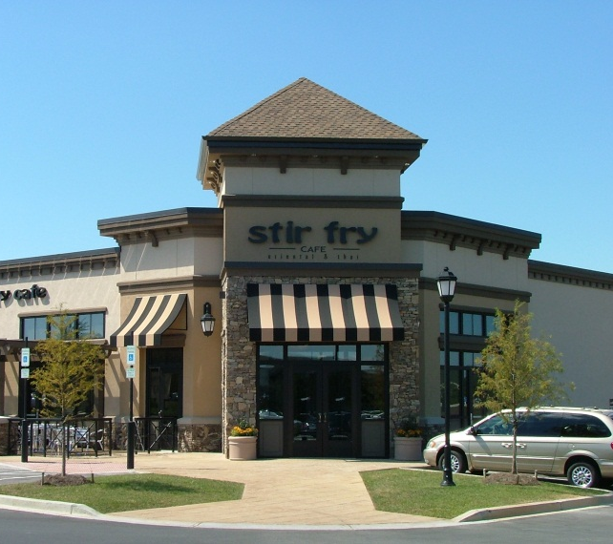
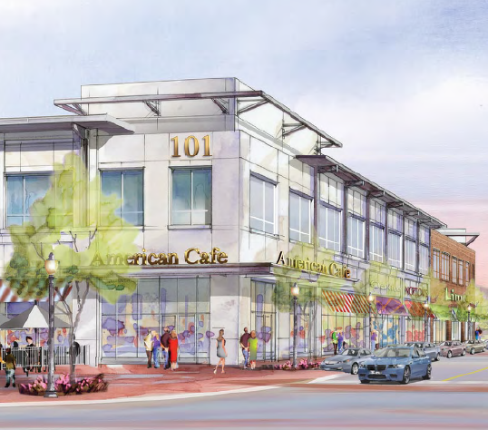
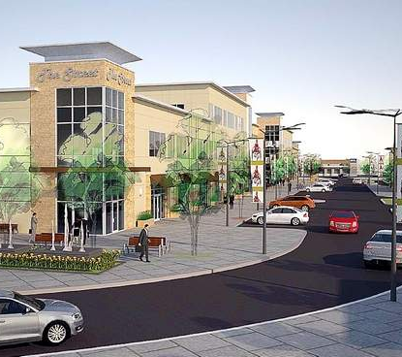
New Projects
Blue Spruce Shoppes Approximately 60,000 square feet of retail, restaurant and office space Located at the corner of Route 22 (William Penn Highway) and Old William Penn Highway at the entrance to both Murrysville and Westmoreland County Tenants include Burgatory, North Park Lounge, Cabana Bar, Specialty Wine & Spirits, Moe’s Southwest Grill, Starbucks, The Goddard School and others | Southpointe Town Center Southpointe Town Center is the final phase of the 800-acre Southpointe development 60,000 square feet of retail and restaurants Development of: Horizon Properties Group, LLC & Institutional Mall Investors LLC | The Street at the Meadows Located at the entrance of the Meadows Casino, across from Tanger Outlets 50,000 square feet of retail 90 luxury apartments Four restaurant sites with patios and additional inline, endcap restaurant opportunities Development of: Horizon Properties Group, LLC

Slide 9
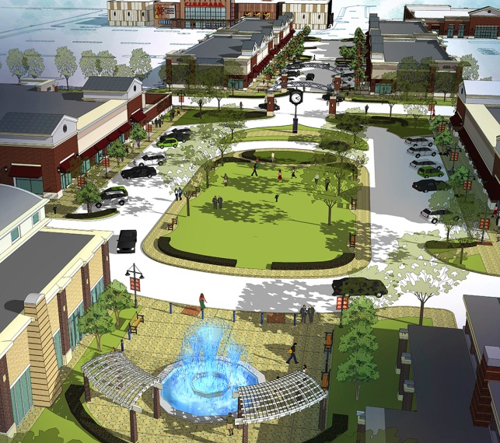
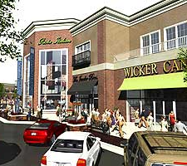
New Projects
McCandless Crossing 1,200,000 square foot mixed-use development located at the intersection of Cumberland Road and McKnight Road First 3 phases include Lowe’s, LA Fitness, Home 2 Suites, 200,000 square foot of office medical space, CVS and restaurants Phase 4 is now underway, includes 12-screen Cinemark, HomeGoods, Trader Joe’s and many national restaurants and retail shops | Siena at St Clair Located at the intersection of Route 19 and Fort Couch Road in Upper St Clair Anchored by Whole Foods with up to 40,000 square feet available Entrance to the center is adjacent to the entrance of South Hills Village and the new Target and Dick’s Sporting Goods

Slide 10
Redevelopments
Century III Mall
Monroeville Mall
Northway Mall
Old Mill (formerly The Foundry)
Parkway Center Mall
Saks Downtown
The Waterfront
Washington Crown Center

Slide 11

















2013/2014 Retailers Expanding
Big Box

Slide 12












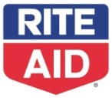











2013/2014 Retailers Expanding
Retailers

Slide 13
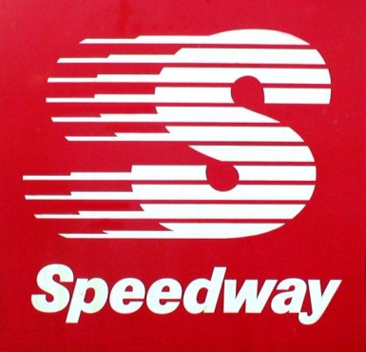



2013/2014 Retailers Expanding
Gas/Convenience

Slide 14





2013/2014 Retailers Expanding
Grocery

Slide 15




2013/2014 Retailers Expanding
Childcare

Slide 16
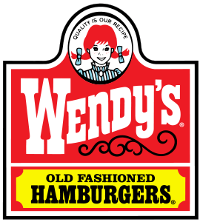

2013/2014 Retailers Expanding
Fast Food Restaurants

Slide 17





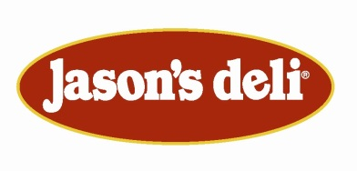











2013/2014 Retailers Expanding
Fast Casual Restaurants

Slide 18
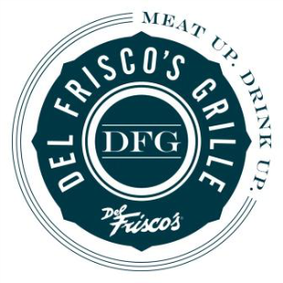


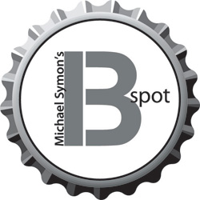


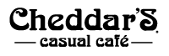







2013/2014 Retailers Expanding
Sit Down Restaurants

Slide 19
Summary
Pittsburgh Pirates are in 1st place
11 substantial new projects under development
8 redevelopments of retail/mixed-use projects
90+ retail tenants seeking opportunities in Western Pennsylvania
Western Pennsylvania is on fire – Let’s make some deals!

