Slide 1
Market Overviews
ICSC 2013 Ohio/West Virginia/Indiana/Western Pennsylvania
Idea Exchange
August 2013
Aaron S. Gilbert Principal
The Gilbert Group Real Estate
203 East Broad Street Columbus, Ohio 43215 614.228.2222 | 800.783.9568 | Fax 614.228.5325 | Cell 614.537.6644 agilbert@gilbertgrouprealestate.com | GilbertGroupRealEstate.com

Slide 3
Columbus, Ohio
Market Fast Facts
2.4 Million People in MSA or 787,000 People in City (Largest in Ohio)
Major Employers include:
Regional Draws: Columbus Zoo & Aquarium, COSI, Easton, Arena District

Slide 4
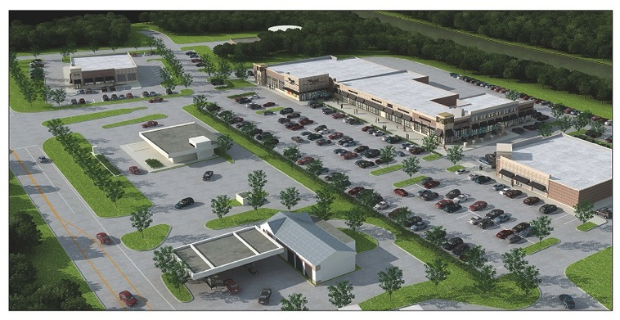
New Developments
Easton Gateway
Northeast
Polaris Retail
North
Ashton Crossing
East
The Shoppes at Wedgewood
Northwest
The Market at Britton Parkway
West

Slide 5
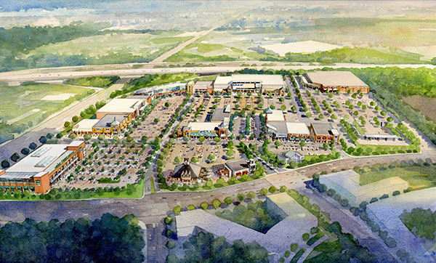
Easton Gateway
• Developer: Georgetown / Steiner
• Project Highlights: 54 acre development that will add 621,000 square feet of additional retail/restaurant space to Easton. Construction is underway for Costco (Fall of 2013). There will be 278,000 square feet of big box space and 150,000 square feet of specialty retail/restaurant space.
With I-270 to the east and Morse Road to the north, Easton Gateway enjoys both extraordinary access and optimum visibility.
• Anchored Tenants: Costco, Whole Foods, REI

Slide 6
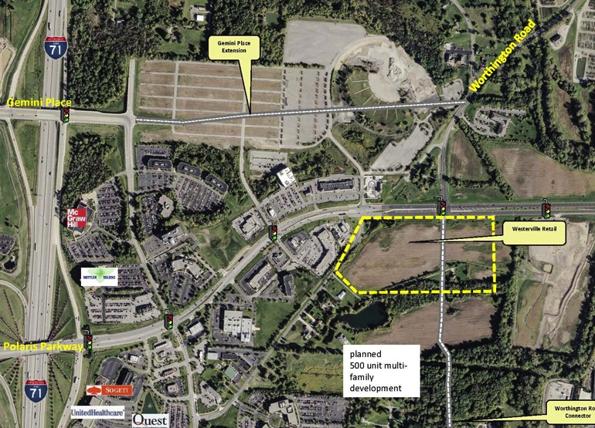
Polaris Retail
• Developer: NP Limited Partnership
• 79.12 acre site located in Westerville on Polaris Parkway
• Project Highlights: East of I-71, the site is at the signalized intersection of Worthington Road and Polaris Parkway. The proposed plan calls for two 26,000sf anchors, 24,000sf of inline retail and multiple out parcel for restaurants.

Slide 7
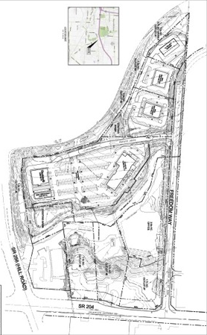
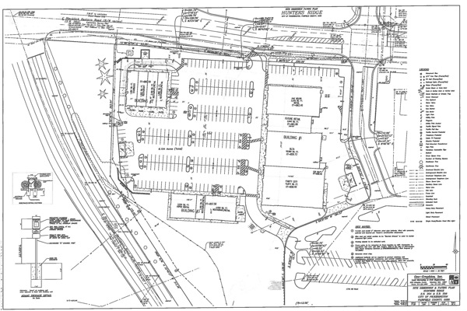
Ashton Crossing
• Developer: Northstar Realty
• Project Highlights: Located at the intersection of SR256 and SR204 with traffic counts above 50,000 vehicles per day. The project south of SR204 has 50,000sf of retail with junior boxes and multiple out parcel strip centers. The project north of SR204 includes multiple out lots for retail/restaurant use.

Slide 8
The Shoppes at Wedgewood
• Project Highlights: Over 40,000 square feet of inline retail and restaurant space available as well as out lots for sale or lease.
• Target expected to open Spring 2014.
• The Shoppes at Wedgewood are located in a prime retail location on Sawmill Parkway in Powell, Ohio, considered to be one of the state’s highest growth corridors. This site offers superb visibility and outstanding accessibility to Powell, Dublin, Columbus, and Worthington.

Slide 9
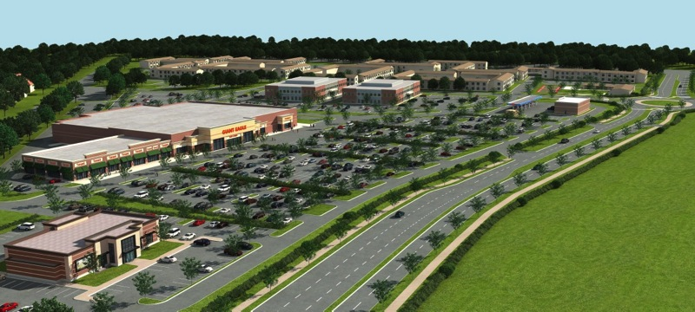
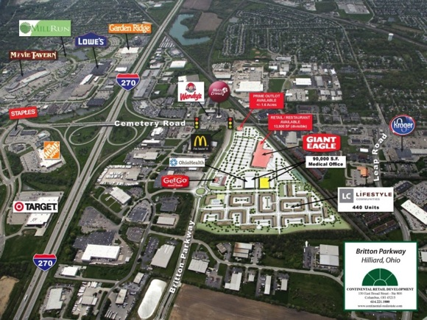
The Market at Britton Parkway
• Developer: Continental Real Estate
• Project Highlights: 55 acre site located at I-270/Cemetery Road/Britton Parkway in Hilliard, Ohio. Includes a new Giant Eagle grocery store, Get Go fuel, 440 Lifestyle Community high end apartments and two medical office buildings.
• Major Area Tenants Include: Target, Home Depot, Kroger, Staples & Lowes

Slide 10
2013/2014 Retailers Expanding
Expanding Retailers/Restaurateurs
For further detail on a specific tenant shown please visit the ICSC website for contact and site expansion information

Slide 11
Retailers New to Market

Slide 12
Retailers Expanding in Market

Slide 13
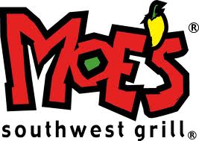
Restaurants New to Market

Slide 14
Restaurants Expanding in Market

